Slide 1

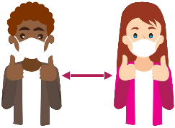


Fitness Cap
A medical cap that gives overall health report of the patient
Which also helps the wearer in maintaining social distancing
Which will helps reduce the burden on medical staff
And will also help reduce the cost of bulky medical equipment's
Tasmiyah Patni - 19302A0055
Alfiya Iraqui - 19302A0054

Slide 2
Work Completed
All the electronic components are bought
Finalized Beanie Cap after testing various types of caps
Started coding for Ultrasonic Distance Sensor
Started coding for Temperature Sensor

Slide 3
Work Planned
Coding for Pulse Rate and Oximeter Sensor, IR Temperature Sensor, Gyroscope
Figuring out how to process the data of the gyroscope for sleep monitoring
Combining the code for all the sensor into one efficiently
Modifying the code in favor of Bluetooth control
Integrating the circuit on the cap

